Slide 1


Slide 2

Welcome To the University of Salford

Slide 3
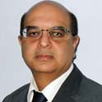
Computing, Science & Engineering
Programme Introduction – Your School
Head of School – Professor Sunil Vadera
Over 2,300 students and 90 staff in 5 subject-specific directorates
Award-winning lecturers & programmes
Leading edge teaching and research facilities
Internationally excellent & world-leading research
Students from over 60 countries

Slide 4
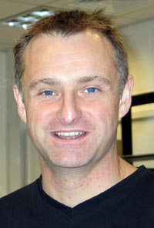
Programme Introduction – Your Directorate
Acoustics, Digital Media, Audio Engineering & Telecomms
Director – Dr Nigel Blackie
Undergraduate programmes in Audio Acoustics, Professional Sound & Video Technology, Computer Networks
Postgraduate programmes in Acoustics, Digital Media and Data Telecommunication Networks
Based on the main campus and Media City UK

Slide 5
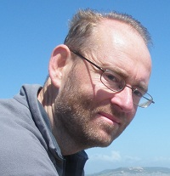
Programme Introduction – Your Programme
BSc(Hons) Professional Sound and Video Technology
Programme Leader – Dave Eustace
Contact Details
Office: MediaCityUK
Phone: 0161 295 5321
Email: D.Eustace@salford.ac.uk

Slide 6
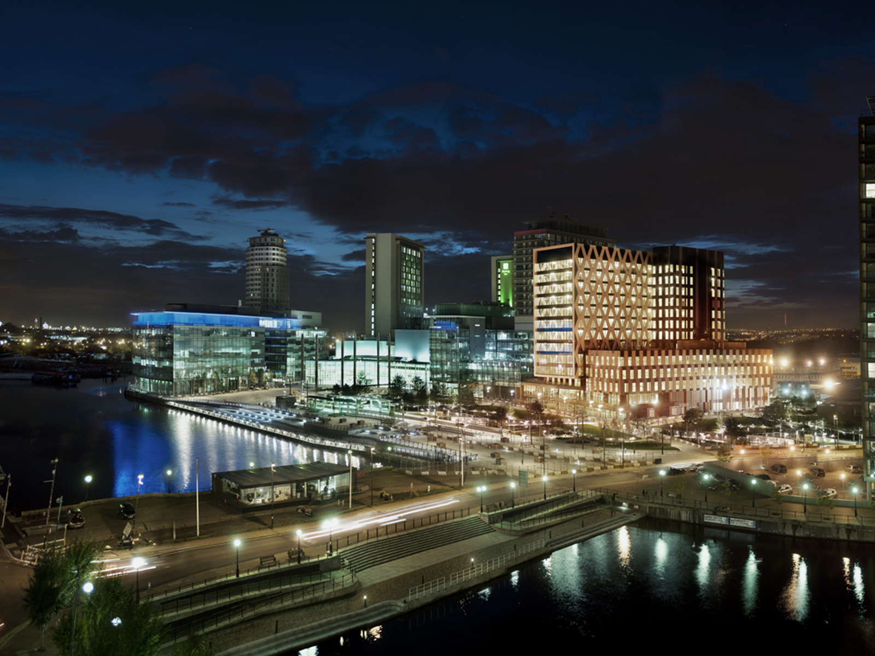

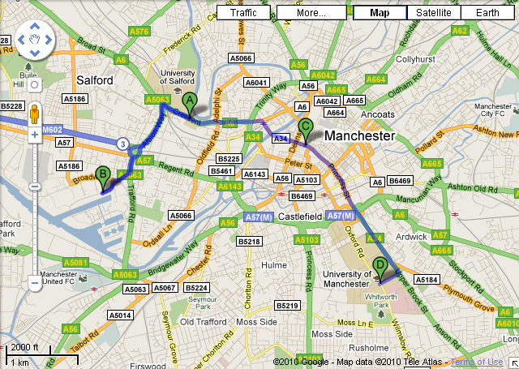
UNIVERSITY CAMPUS
CITY CENTRE
MEDIA CITY:UK

Slide 7
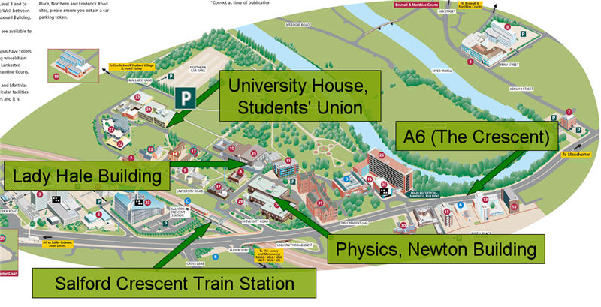
The Main Campus
University House, Students’ Union
A6 (The Crescent)
Lady Hale building
Newton Building, School of Computing, Science & Engineering
Salford Crescent Train Station

Slide 8

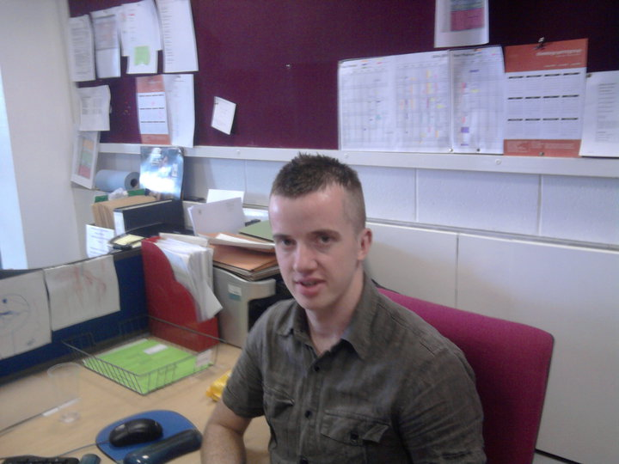
Newton Building
Newton Building
Home of the School of Computing, Science & Engineering
Location of the School Office – 1st Floor, Room 132
Daniel Wadsworth
Programme Administrator

Slide 9
School Office Services
Finding your way – where should I be now? where is the room?
Finding a lecturer – location & contact information
Non-electronic submission of coursework
Late registration
Records enquiries – results, module registration, etc.
UKBA attendance forms – box outside the office

Slide 10
School Office Services
Transfers
Suspensions
Placements
Withdrawals
Interruptions
PMCs
Self Service Student Portal
The Student Portal allows you to make PMC requests, or other requests for programme or module changes, study interruptions, or to make a request to withdraw from your course.
http://students.salford.ac.uk/selfservice.php

Slide 11
School Office Opening Times
Monday 8.45am – 4.30pm
Tuesday 8.45am – 4.30pm
Wednesday 8.45am – 4.30pm
Thursday 8.45am – 4.30pm
Friday 8.45am – 4.30pm
OPEN

Slide 12
Access to specialist rooms
Specialist rooms secured by access system
Accessible only to students with valid student ID card
Pick Up your student ID card during University Check-In – see your Induction Week timetable for when and where

Slide 13
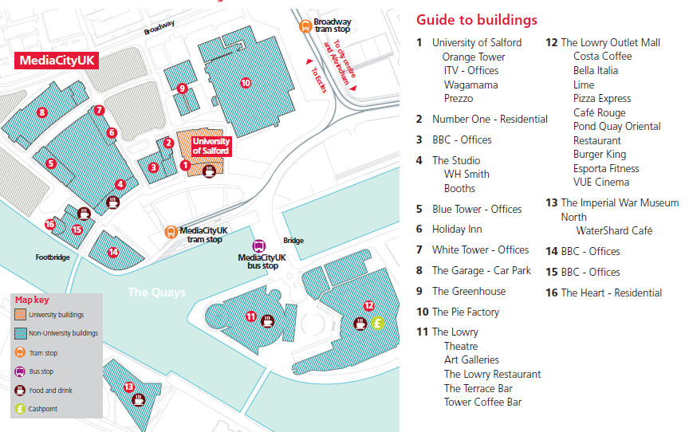
MediaCityUK

Slide 14
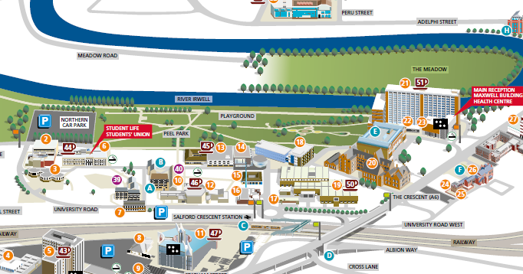

Travelling to MediaCityUK
City Connect 50
Circular route between Salford Central train station, Chapel Street, the University of Salford, Salford Crescent, Salford Shopping Centre, MediaCityUK and Salford Quays
University of Salford staff and students travel free between Adelphi Street/Oldfield Road and MediaCityUK on production of a valid ID card.
The service operates:
Monday to Saturday daytime - every 10 minutes
Monday to Saturday evening - every 15 minutes
Sunday daytime - every 15 minutes
Sunday evening - every 20 minutes

Slide 15
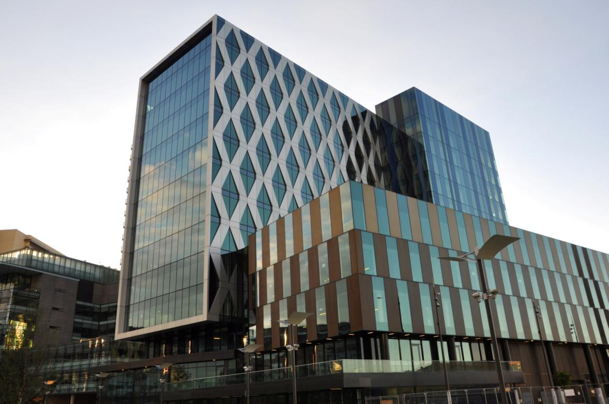
MediaCityUK – General Information
Students must produce their student ID to access MCUK
Fire Alarm is tested at 9:30am each Friday, unless otherwise stated
In the event of an activation leave by the nearest safe exit, NOT by the main staircase. The fire assembly point is located on the main piazza by the BBC Screen
No smoking directly outside UOS entrance
Visitors to non-public areas of the building must be pre-booked with reception
Building opening hours are 7am-10pm all week, closed on Bank Holidays
Café open 08:30 – 16:30, Monday to Friday
Any issues – Student Life desk located on 1st floor, or Main Reception

Slide 16
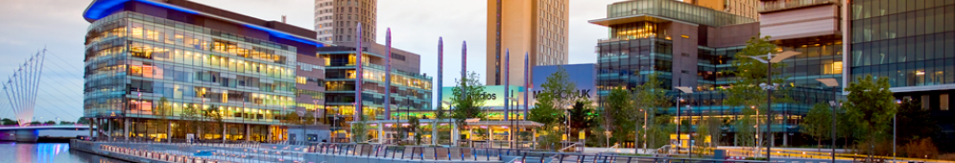
Admin Support at MediaCityUK
The first port of call: Student Support Desk
Located on the first floor
Staffed by Student Information, the Library, and Student Life
Open during office hours (9.00 am – 6.00 pm)
There are also touch-screen kiosks located throughout the building which operate 24/7 and from which you can get advice and information

Slide 17
Support Desk will help with …
General administration and enquiries - e.g. directions, responding to security alarms
Library services - e.g. book loans, catalogue searches, printing and copying problems
IT Support - e.g. student email problems, network faults and referrals to ITS helpdesk
Academic related advice - e.g. appeals, PMCs, assessment regulations, coursework receipting
Room booking and timetabling - e.g. room booking enquiries, exam timetable enquiries
Student documentation - e.g. council tax exemption certificates, proof of study letters, ID cards
Financial advice and guidance - e.g. tuition fees, emergency loans and funding, budgeting and financial advice

Slide 18
Support Desk will help with …
Immigration information - e.g. visa advice and guidance
Accommodation - e.g. applying for University accommodation, emergency accommodation, fault reporting, information about private accommodation
Disability - e.g. academic support for disabled students, student support plans, dyslexia screening, equipment loans, financial support
Student health and safety enquiries
Counselling and well-being services - e.g. information, guidance and advice on dealing with student well-being issues
Careers and employability - e.g. careers advice, changing courses, job vacancies and work experience, CV and interview advice, careers events at MediaCityUK

Slide 19
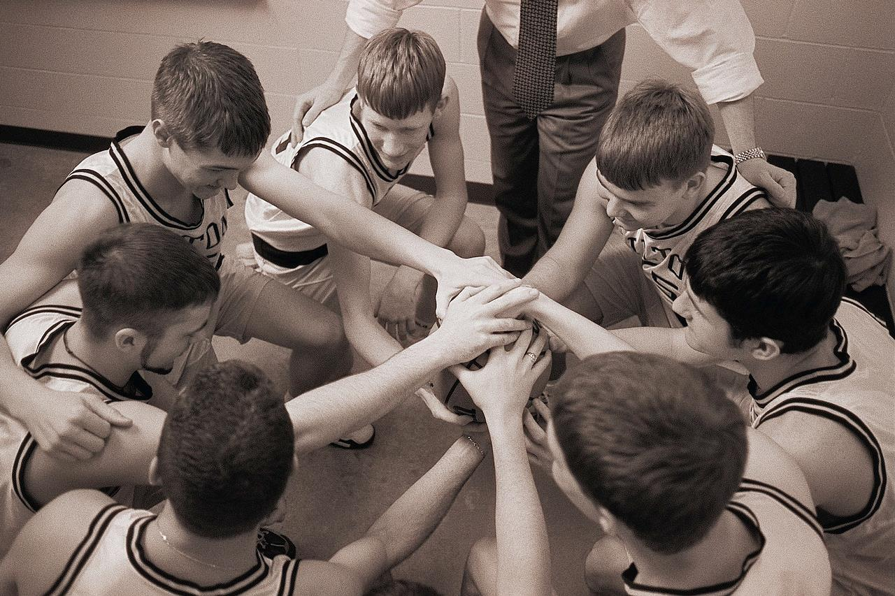
… Personal Tutors
And also …
And also …
All students are assigned a Personal Tutor, who is available for academic and personal advice:
Academic progress
Settling in at University
Personal matters
References

Slide 20
Safety Legislation
Safety Information (1)
The University operates under the same Health & Safety
legislation as any place of work
Health & Safety at Work Act
Control of Substances Hazardous to Health
Electricity at Work Act
You are expected to be aware of safety
issues and ensure you minimise any danger
to yourself and others.

Slide 21
Basic Safety Considerations
Safety Information (2)
DO NOT ignore alarms
Observe safety signs and act on them.
If in doubt, ASK A MEMBER OF STAFF
READ DOCUMENTS
There may be additional safety information in your
Programme Handbook
Laboratory Handouts

Slide 22
Fire Safety
On hearing a continuous fire siren
IMMEDIATELY leave the building by the nearest fire route.
Assemble in nominated area, away from the building.
Don’t re-enter the building until instructed to do so by a fire warden.
DO NOT USE THE LIFTS

Slide 23

Safety Signs
There are four types of safety sign you should be aware of:
BLUE: Mandatory Actions
RED: Prohibitory Notices
YELLOW: Warning Notices
GREEN: Safe Conditions

Slide 24
First Aid
Be aware of the two easiest ways to get First Aid treatment
In Newton Building, go to the School Office
At MediaCity go to the Security Desk (Ground Floor)
Phone: Internal 53333 External 0161 295 3333
Put in your mobile as UNIVERSITY EMERGENCY NUMBER

Slide 25
Safety Stuff
College Health and Safety Co-ordinator:
David Lamb: D.C.Lamb@salford.ac.uk)
Safety Web pages:
www.hr.salford.ac.uk/safety

Slide 26
Enjoy your time at the University and make the most of the opportunities at Media City

